Slide 1

Java Programming
Introduction

Slide 2
Outline
Learning goal
Case study
Programming processes
What is Java?
The first java program

Slide 3
Goal
Learn enough Java to solve some real problems…
Case study:
BMI Statistics
Tetris

Slide 4

BMI statistics problem
Input ID, name, height and weight of each student
Store the above information into a text file
Calculate the BMI of each student
Sort the student by each attribute in ASCENDING or DESCENDING order
Calculate the range, mean, media, mode the BMIs
According to the values, divide BMIs into ten same size range, and count the students in each range, lastly print the number of students in each range on the screen
Draw a histogram to show the distribution of the BMIs

Slide 5
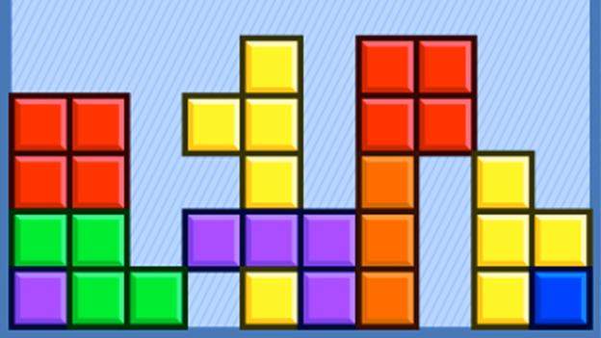
Tetris
Tetris is a tile-matching puzzle video game.
The goal of Tetris is to score as many points as possible by clearing horizontal lines of Blocks. The player must rotate, move, and drop the falling Tetriminos inside the Matrix (playing field). Lines are cleared when they are filled with Blocks and have no empty spaces.

Slide 6
Projects/Games
Each team choose one of the following projects by casting lots.
Sudoku
Crossword
Blockies
Cube Crash
Bubble Shooter
Connection Game
Maze game

Slide 7
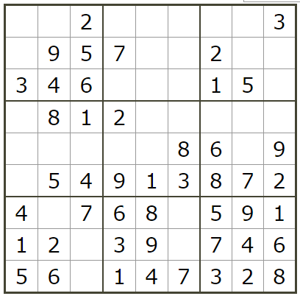
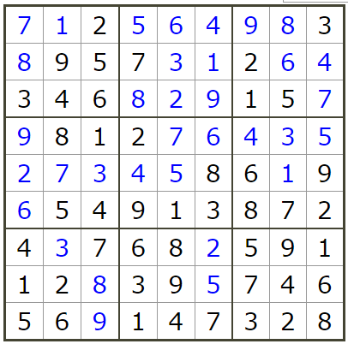
Sudoku
Sudoku is a combinatorial number-placement puzzle. Sudoku played on a grid consisting of 9 rows and 9 columns.
To complete a Sudoku, you need to fill in the empty cells so that each row, each column and each of nine 3x3 subgrids must contain all the digits between 1 and 9, and each digit can appear only once.
SEE: http://www.websudoku.com/

Slide 8
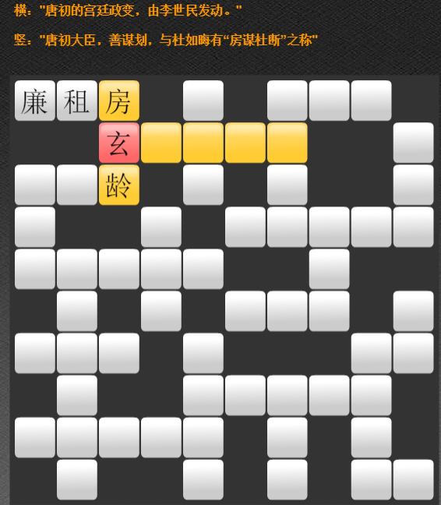
Cross Word Puzzle
A crossword is a word puzzle that normally takes the form of a square or a rectangular grid of white and black shaded squares. The goal is to fill the white squares with letters, forming words or phrases, by solving clues which lead to the answers. In languages that are written left-to-right, the answer words and phrases are placed in the grid from left to right and from top to bottom. The shaded squares are used to separate the words or phrases.
See: http://www.7k7k.com/swf/133612.htm

Slide 9
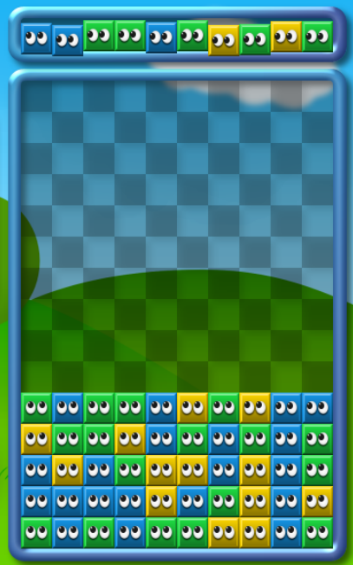
Blockies
The goal of Blockies is fairly simple. You have to remove same-colored blocks by clicking on groups of three or more as they accumulate on the bottom of the screen. As you work to remove blocks, new rows will be falling from the top of the screen.
SEE: http://netpuzzlegames.com/blockies

Slide 10
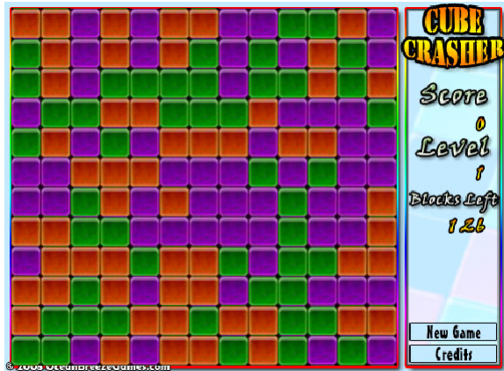
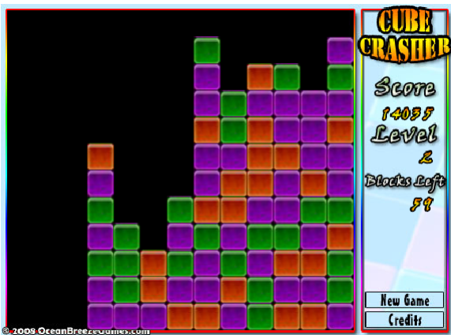
Cube Crash
Click on groups of three or more same colored cubes that are touching on at least one edge. The bigger the group, the more points you get.
As the game progresses more colors are introduced and you are required to remove more cubes to progress to the next level making the game much more difficult.
SEE: http://netpuzzlegames.com/cube-crash

Slide 11
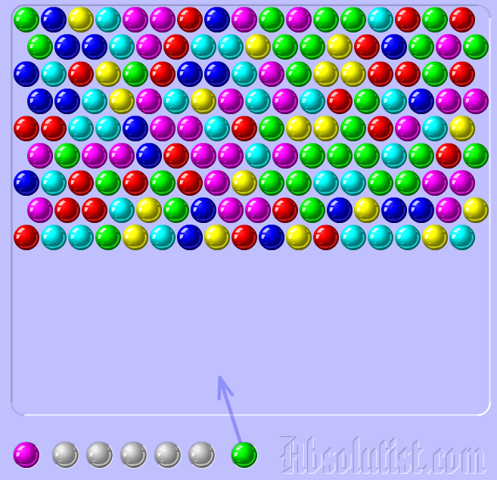
Bubble Shooter
there is a bunch of different colored balls lined up in the screen. On average, there are 17 colored balls per row. Usually, there are 5 to 6 colored balls when the game starts. There are 19 rows of balls and they are randomly colored. You should clear them off and score as MUCH as you can. You do that by shooting more colored balls into the bunch. When three or more balls of the same color come together, they will explode
SEE: http://netpuzzlegames.com/bubble-shooter

Slide 12
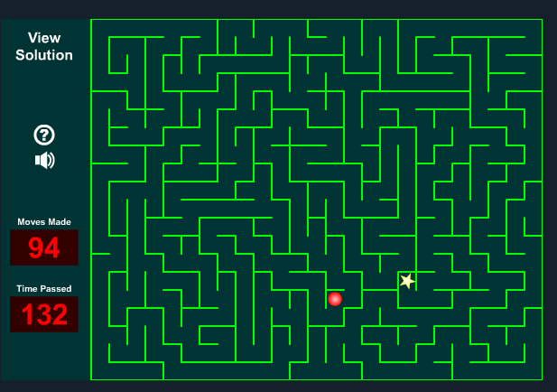
Maze Game
Use the arrow key to move the red ball until you arrive at the yellow star. Win the game as soon as possible. You will lose game if you can not reach the yellow star. Record the user and score in a text file, and you can see the ranking list.
See: http://www.sheppardsoftware.com/braingames/maze/maze.htm

Slide 13


Solving problems by Programming
Problem
Result
Computational Thinking
Programming
Language
Source
code
Running
Programming & Debugging
translating
Algorithm
Program

Slide 14

Computational thinking
Jeannette M. Wing
Corporate Vice President of Microsoft Research
Was President's Professor of Computer Science, Computer Science Department, Carnegie Mellon University
Computational thinking is a fundamental skill for everyone, not just for computer scientists.
Computational thinking involves solving problems, designing systems, and understanding human behavior, by drawing on the concepts fundamental to computer science.

Slide 15
Program
A program is a sequence of instructions that are executed by a CPU.
A Instruction specify how to perform a computation.
CPU instructions (or Machine Language)
They are encoded as binary numbers.

Slide 16
Instruction
Each instruction performs a very specific task, such as a load, a jump, or an ALU operation on a unit of data in a CPU register or memory.
Examples:
adding the registers 1 and 2 and placing the result in register 6 is encoded:
000000 00001 00010 00110 00000 100000
jumping to the address 1024:
000010 00000 00000 00000 10000 000000

Slide 17
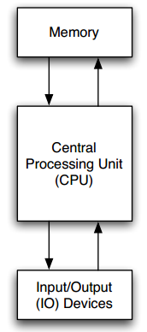
Program
Main memory holds machine language programs and data. These are encoded as binary numbers.
The CPU fetches machine language instructions from memory one after another and executes them, which is called of fetch-and-execute cycle.

Slide 18
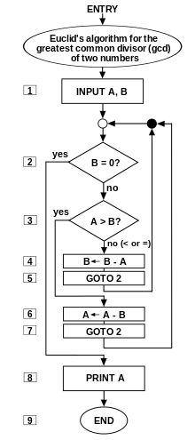
Algorithm
An algorithm is a sequence of steps that specifies how to solve a problem.
Computer science is the science of algorithms, including their discovery and analysis.
The 1st algorithm (B.C.300)→

Slide 19
Pseudocode
Pseudocode is an informal high-level description of the operating principle of a computer program or algorithm.
The following pseudocode determines whether a year is a leap year or a common year in the Gregorian calendar:
if (year is not divisible by 4) then (it is a common year)
else if (year is not divisible by 100) then (it is a leap year)
else if (year is not divisible by 400) then (it is a common year)
else (it is a leap year)

Slide 20
Pseudocode
The pseudocode for determining whether a year is a leap year also can be
If ((year is divisible by 4) and (year is not divisible by 100)) or (year is divisible by 400) then (it is a leap year)
else (it is a common year)

Slide 21
Programming Language
A programming language is a formal computer language or constructed language designed to communicate instructions to a machine, particularly a computer.
Easier to understand than CPU instructions
completely unambiguous and very strict about syntax rules
Needs to be translated for the CPU to understand it

Slide 22
Programming Languages
Some basic instructions appear in every language.
input: Get data from the keyboard, a file, a sensor, or some other device.
output: Display data on the screen, or send data to a file or other device.
math: Perform basic mathematical operations like addition and division.
decisions: Check for certain conditions and execute the appropriate code.
repetition: Perform some action repeatedly, usually with some variation.

Slide 23
Source code
Source code is any collection of programming language instructions, (possibly with comments), written using a human-readable computer language, usually as ordinary text.
Comment is a part of a program that contains information about the program but has no effect when the program runs.

Slide 24
Source code: Euclid’s Algorithm
int gcd(int K, int M) {
int k = K; // In order to state a simple, elegant loop invariant,
int m = M; // we keep the formal arguments constant and use
// local variables to do the calculations.
// loop invariant: GCD(K,M) = GCD(k,m)
while (k != m) {
if (k > m)
{ k = k-m; }
else
{ m = m-k; }
}
// At this point, GCD(K,M) = GCD(k,m) = GCD(k,k) = k
return k;
}

Slide 25
Programming
programming is the process of breaking down a large, complex task into smaller and smaller subtasks. The process continues until the subtasks are simple enough to be performed with the basic instructions provided by the computer.

Slide 26
Translating
There are two ways to translate the source code to the program that can be executed by computers.
Compiling
This translation can be done by a program called a compiler.
compiler translates the program all at once.
Interpreting
Interpreter translates the programming language source code instruction-by-instruction, as necessary.
An interpreter is a program that acts much like a CPU, with a kind of fetch-and-execute cycle.

Slide 27
Debugging
Designing algorithms and writing code is difficult and error-prone. For historical reasons, programming errors are called bugs, and the process of tracking them down and correcting them is called debugging.
debugging attempts to execute a program with the intent of finding bugs.
Note: The job of debugging is an iterative process as when one bug is fixed, it can illuminate other, deeper bugs, or can even create new ones.

Slide 28
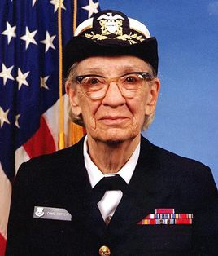
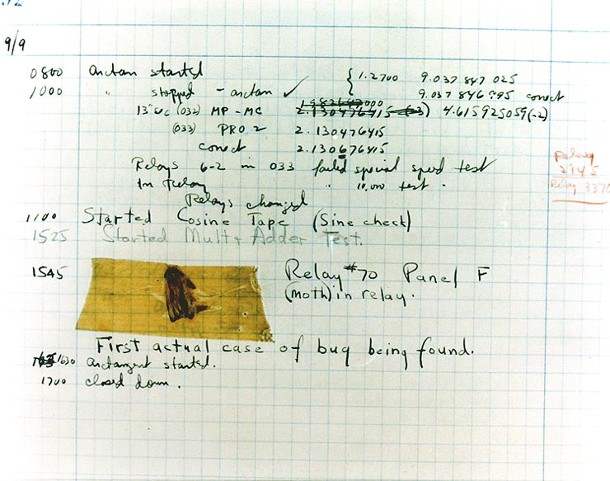
Anecdote
In 1946, when computer scientist Grace Hopper was released from active duty, she joined the Harvard Faculty at the Computation Laboratory where she continued her work on the Mark II and Mark III. Operators traced an error in the Mark II to a moth trapped in a relay, coining the term bug. This bug was carefully removed and taped to the log book. Stemming from the first bug, today we call errors or glitches in a program a bug.

Slide 29
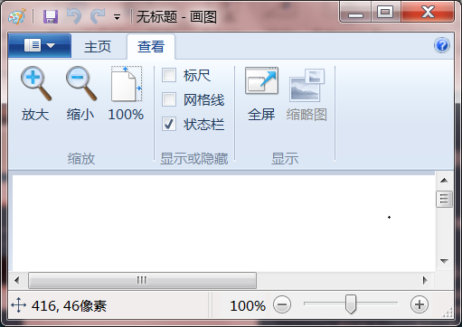
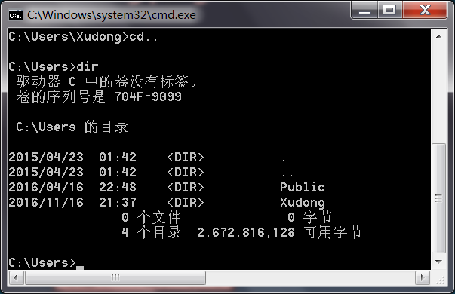
Running programs
There are two ways to run and interact with the programs.
CLI (command-line interface)
also known as command-line user interface, console user interface, and character user interface (CUI)
GUI (graphical user interface)
We will introduce GUI programming in the last chapter

Slide 31
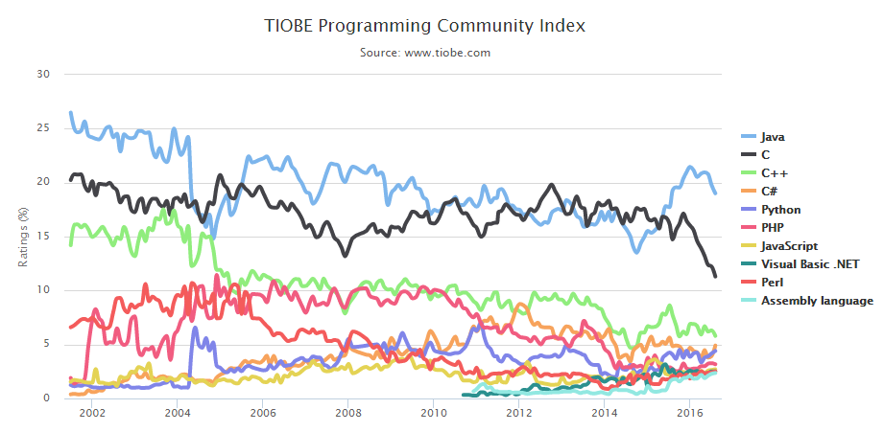
Java
“Most popular” programming language
Runs on a “virtual machine” (JVM)
More complex than some (eg. Python)
Simpler than others (eg. C++)

Slide 32
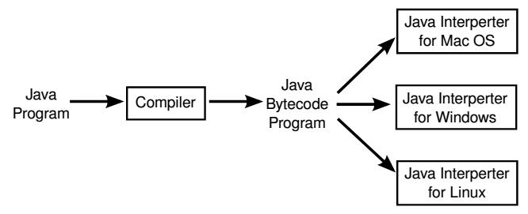
Write once, run anywhere!
Java virtual machine (JVM) is an abstract computing machine that enables a computer to run a Java program.

Slide 33
Write once, run anywhere!
Java Runtime Environment (JRE) is a software package that contains what is required to run a Java program. It includes a Java Virtual Machine implementation together with an implementation of the Java Class Library.
Java Development Kit (JDK) is a superset of a JRE and contains tools for Java programmers, e.g. a javac compiler.

Slide 34
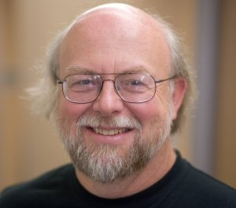
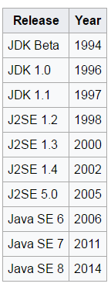


Java history
The Java platform and language began as an internal project at Sun Microsystems in December 1990.
On January 27, 2010, Sun was acquired by Oracle Corporation for US$7.4 billion.
In this course, we will use Java SE 8;
Reading materials:
https://en.wikipedia.org/wiki/Java_(software_platform)
https://en.wikipedia.org/wiki/Java_version_history

Slide 35
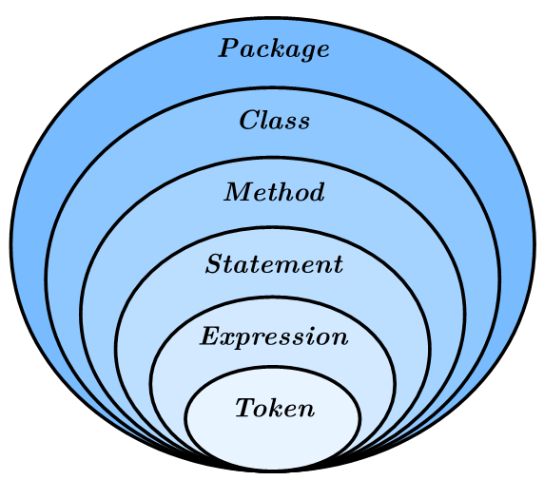
Big picture of Java
Java is an object-oriented programming language. It includes the following components.

Slide 36
Big picture of Java
A package is a collection of classes.
A class is a collection of methods (not precise).
A method is a named sequence of statements.
A statement is a line of code that performs a basic operation. A statement always ends with a semicolon (;)
An expression is a combination of tokens.
Tokens include keywords, identifiers, literals, operators, punctuation marks.
The java source code are made up of tokens and white spaces.
Notes:
System.out.println(“Hello World!”) is a statement which print “Hello World!” on the screen!

Slide 37
Java Program Structure
package PACKAGENAME;
public class CLASSNAME {
public static void main(String[] arguments) {
STATEMENTS
}
}
Note: The name of the class has to match the name of the file it is in.

Slide 38
Case-sensitive
Java is “case-sensitive”, which means that uppercase and lowercase are not the same.

Slide 39
1st Program
package edu.hit.java.intro;
public class Hello { public static void main(String[] arguments) { // Program execution begins here System.out.println("Hello world!"); } }
Note: This class has to be in a file named Hello.java
This program displays “Hello World!” on the screen.

Slide 40
1st Program
Java uses curly braces {} to group things together.
In Hello.java, the outermost braces contain the class definition, and the inner braces contain the method definition.
The line that begins with two slashes (//) is a comment, which is a bit of text in English or other language that explains the code. When the source code are translated to machine code, they will be ignored.

Slide 41
The main method
The name and format of main method is special: when the program runs, it starts at the first statement in main and ends when it finishes the last statement.
Programs can define more than one method.

Slide 42
Code Style
package edu.hit.java.intro;
public class Hello { public static void main(String[] arguments) { // Program execution begins here System.out.println("Hello world!"); } }
public class Hello {public static void main(String[] arguments){ System.out.println("Hello world!");}}
They are legal but ugly!

Slide 43
Good Code Style
package edu.hit.java.intro;
public class Hello { public static void main(String[] arguments) { // Program execution begins here System.out.println("Hello world!"); } }

Slide 44
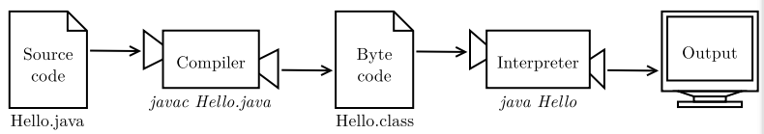
Compiling and running Java

Slide 45
Type of Errors
Compile-time error
For example, If you forget the semicolon at the end of the print statement, you might get an error message like this: File: Hello.java [line: 5] Error: ';' expected
Run-time error
For example, if you accidentally divide by zero you will get a message like this: Exception in thread "main" java.lang.ArithmeticException: / by zero at Hello.main(Hello.java:5)
Notes:
Compile-time error: It occurs when you violate the syntax rules of the Java language.
run-time error: it does not appear until after the program has started running.

Slide 46
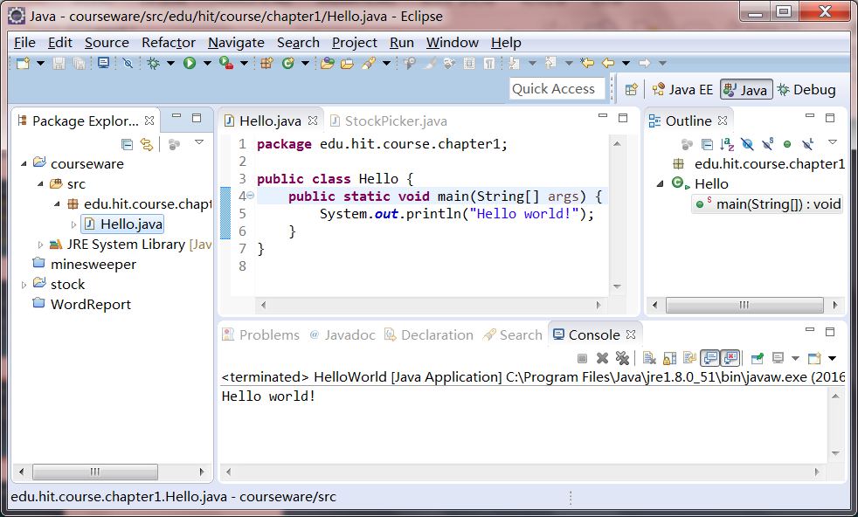
IDE
An integrated development environment (IDE) is a software application that provides comprehensive facilities to computer programmers for software development.
An IDE normally consists of a source code editor, build automation tools and a debugger.
Most modern IDEs have intelligent code completion. Some IDEs, such as NetBeans and Eclipse, contain a compiler, interpreter.

Slide 47
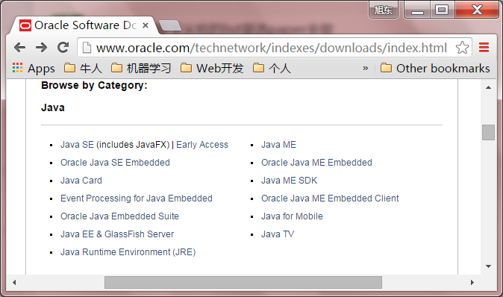
Installing JDK
http://www.oracle.com/technetwork/indexes/downloads/index.html

Slide 48
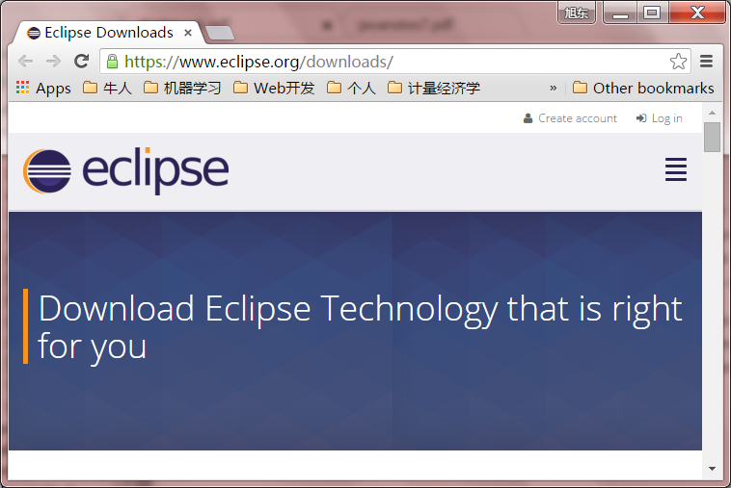
Installing IDE
https://www.eclipse.org/downloads/

Slide 49
Demo

Slide 50


